Slide 1

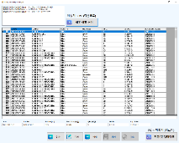
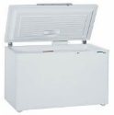


Weekly EED Activity – WW38
K5 / FCBGA
FCBGA / Underfill
New
MFG1 / EED
K5 FCBGA, Freezer underfill inventory management SW development
NA
NA
MFG requested EE to develop a program to check and manage the underfill inventory in the freezer from the user's PC.
EE developed a program to manage inventory by connecting to the thawing machine.
[Problem Description]
[Action Taken]
The operator must go to the freezer & thawing PC for inventory
Operator checked inventory manually
Inventory check
Data edit (add, remove)
Auto updates with the Thawing PC
Manual check
Inventory check program
Cause : No program to manage material. (Only excel)
Method : Developed S/W for use on multiple PC's
Cost save : $5K/1set
SFI : 0.11 (Non MFG Office, 1.0 hr/day vs. 0.16 hr/day)
Work efficiency improvement
HyunSu Park (DongHwi Kim@MFG) / ww38 ’22 K5EE

